Slide 1


ONLINE TICKET BOOKING SYSTEM
Presented by :-
M. VENKATA SAI
192110433
CSA0936_Java Programming

Slide 2
S.NO | Topics | Page numbers
1 | Problem Description and project Requirements
2 | Source code
3 | Screen Short
4 | Readme File Content

Slide 3
Abstrate :-
This Java program generates a monthly calendar for a specified year and month. It begins by prompting the user to input the desired year and month. The program then calculates the day of the week for the first day of the specified month and year and proceeds to print a formatted calendar for that month. It ensures the correct alignment of days of the week, accounts for the number of days in each month, and correctly handles leap years for February. The result is a clear and well-organized textual representation of the chosen month's calendar.
his Java program serves as a versatile tool for generating monthly calendars tailored to user-specified years and months. It initiates the interaction by prompting the user to input the desired year (e.g., 2023) and month (in the range 1-12). After capturing these inputs, the program constructs a structured calendar output for the given month and year.
The generated calendar is presented in a well-organized format, with the days of the week (Sunday, Monday, Tuesday, etc.) displayed at the top. To ensure appropriate alignment, leading spaces are added for the days preceding the first day of the month. The code also dynamically adapts to the number of days in the chosen month, taking into account shorter months (30 or 28 days) and leap years (29 days in February) for accurate calendar construction.
The final output is a clear and visually appealing textual representation of the specified month's calendar, with dates and weekdays arranged in a grid. This program effectively handles user input, calculates dates, and produces a useful and aesthetically pleasing result, serving as a practical tool for generating monthly calendars for a given year and month.

Slide 4
INTRODUCTION :-
This Java program serves as a practical calendar generator, allowing users to input a year and month, and then producing a clear and well-structured textual representation of the calendar for that specific month. It's a user-friendly tool for creating custom monthly calendars, useful for various scheduling and planning purposes.
The code's user-centric approach and practical functionality make it a versatile tool for various applications. Whether used for personal scheduling, work-related planning, or educational purposes, this program simplifies the process of generating monthly calendars. Its clear and structured output provides users with an easily readable view of their chosen month, making it a valuable resource for enhancing time management and organization.

Slide 5
EXPLANATION :-
Certainly, here are the key points about the provided Java code:
User Input: The program prompts the user to input a year and a month.
Date Calculation: It calculates the day of the week for the first day of the specified month and year.
Dynamic Month Handling: The code adapts to varying month lengths, considering both shorter months (30 or 28 days) and leap years (29 days in February).
Formatted Output: The program prints a well-organized monthly calendar, aligning the days of the week correctly.
Practical Use: This code is a user-friendly tool for creating custom monthly calendars, useful for planning and scheduling.

Slide 6
SOURCE CODE :-
import java.util.Calendar;
import java.util.Scanner;
import java.text.SimpleDateFormat;
public class CalendarDisplay {
public static void displayCalendar(int year, int month) {
Calendar calendar = Calendar.getInstance();
calendar.set(year, month - 1, 1);
SimpleDateFormat sdf = new SimpleDateFormat("MMMM yyyy");
System.out.println(sdf.format(calendar.getTime()));

Slide 7
System.out.println("Sun Mon Tue Wed Thu Fri Sat");
int startDay = calendar.get(Calendar.DAY_OF_WEEK) - Calendar.SUNDAY;
int maxDay = calendar.getActualMaximum(Calendar.DAY_OF_MONTH);
for (int i = 0; i < startDay; i++) {
System.out.print(" ");
}
for (int day = 1; day <= maxDay; day++) {
System.out.printf("%3d ", day);
if ((startDay + day) % 7 == 0) {
System.out.println();
}
}

Slide 8
System.out.println(); // Ensure a new line after the calendar
}
public static void main(String[] args) {
Scanner scanner = new Scanner(System.in);
while (true) {
System.out.println("Menu:");
System.out.println("1. Display Calendar");
System.out.println("2. Exit");
System.out.print("Enter your choice: ");
int choice = scanner.nextInt();
switch (choice) {
case 1:
System.out.print("Enter the year: ");
int yearInput = scanner.nextInt();

Slide 9
System.out.print("Enter the month (1-12): ");
int monthInput = scanner.nextInt();
if (isValidInput(yearInput, monthInput)) {
displayCalendar(yearInput, monthInput);
} else {
System.out.println("Invalid input. Please enter a valid year and month.");
}
break;
case 2:
System.out.println("Exiting the program. Goodbye!");
scanner.close();
System.exit(0);
default:
System.out.println("Invalid choice. Please enter 1 or 2.");
}
}
}

Slide 10
private static boolean isValidInput(int year, int month) {
return year > 0 && month >= 1 && month <= 12;
}
}

Slide 11
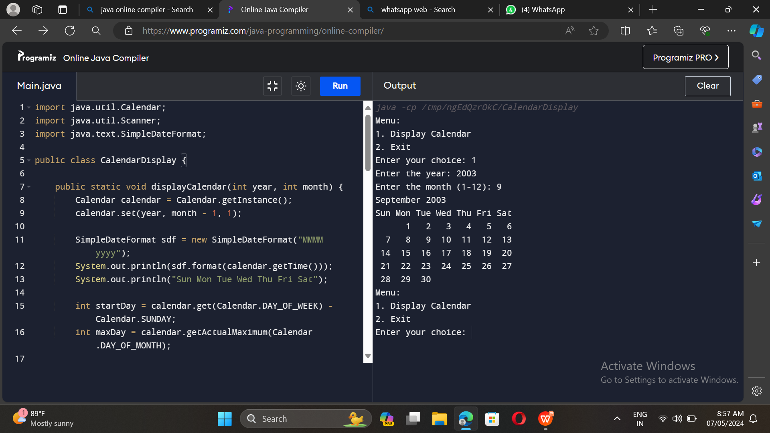
OUTPUT :-

Slide 12
CONCLUSION :-
In conclusion, the provided Java program is a valuable utility for generating customized monthly calendars. It facilitates user interaction by prompting for a specific year and month and subsequently constructs a well-structured textual calendar based on the input. The program's use of the Java Standard Library and date-time functions ensures accurate date calculations, including the precise determination of the day of the week for the first day of the specified month.
The code's adaptability to varying month lengths and its handling of leap years further enhance its utility. It allows for clear and organized calendar outputs, aligning the days of the week correctly, making it suitable for a range of applications, from personal scheduling to work-related planning. In a practical sense, this program simplifies the process of creating custom calendars, offering users a user-friendly and efficient tool for better organization and time management.

